Slide 1
Numerical Methods Sessional ICE 2142
Mursheda Nusrat Della
Lecturer
Dept. of ICE
BAUET
Lab 4

Slide 2
Curve fitting
The process of construction of y(x) to fit a table of data point is called curve fitting.
A table of data may belong to one of the following category
Table of values of well defined function :
e.g: Logarithmic Tables , Trigonometric Tables, Interest Table Etc.
Data tabulated from measurement during experiment:
Relation Between Voltage And Current Etc.

Slide 3
interpolation
The method of constructing a function and estimating values at non tabular points is called interpolation.
Different method of interpolation
i. Lagrange interpolation
ii. Newton’s interpolation
iii. Newton Gregory forward interpolation
iv. Spline interpolation

Slide 4
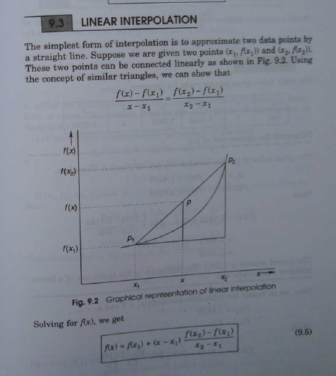
Linear interpolation

Slide 5
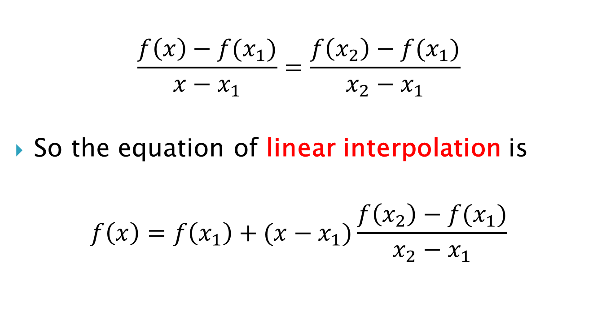
$$\frac{f\left(x\right)−f(x_{1})}{x−x_{1}}=\frac{f\left(x_{2}\right)−f(x_{1})}{x_{2}−x_{1}}$$
So the equation of linear interpolation is
$$f\left(x\right)=f\left(x_{1}\right)+(x−x_{1})\frac{f\left(x_{2}\right)−f(x_{1})}{x_{2}−x_{1}}$$

Slide 6
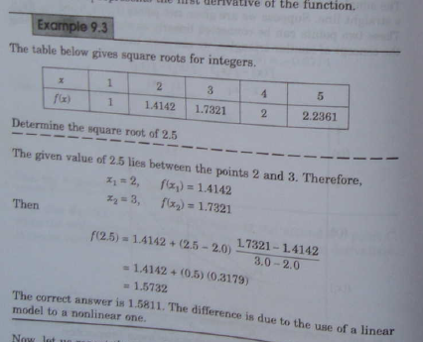

Slide 7
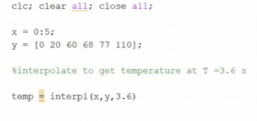

Slide 8
Experiment name: Study on the root finding of equations using linear interpolation method by MATLAB with exercise

Slide 9
MATLAB code
clc;
clear all;
close all;
x = 2.5;
x1 = 2;
fx1=1.4142;
x2=3;
fx2=1.7321;
fx = fx1 +((x-x1)*(fx2-fx1))/(x2-x1);
fprintf('%f\n',fx);
output:
1.573150

